Slide 1

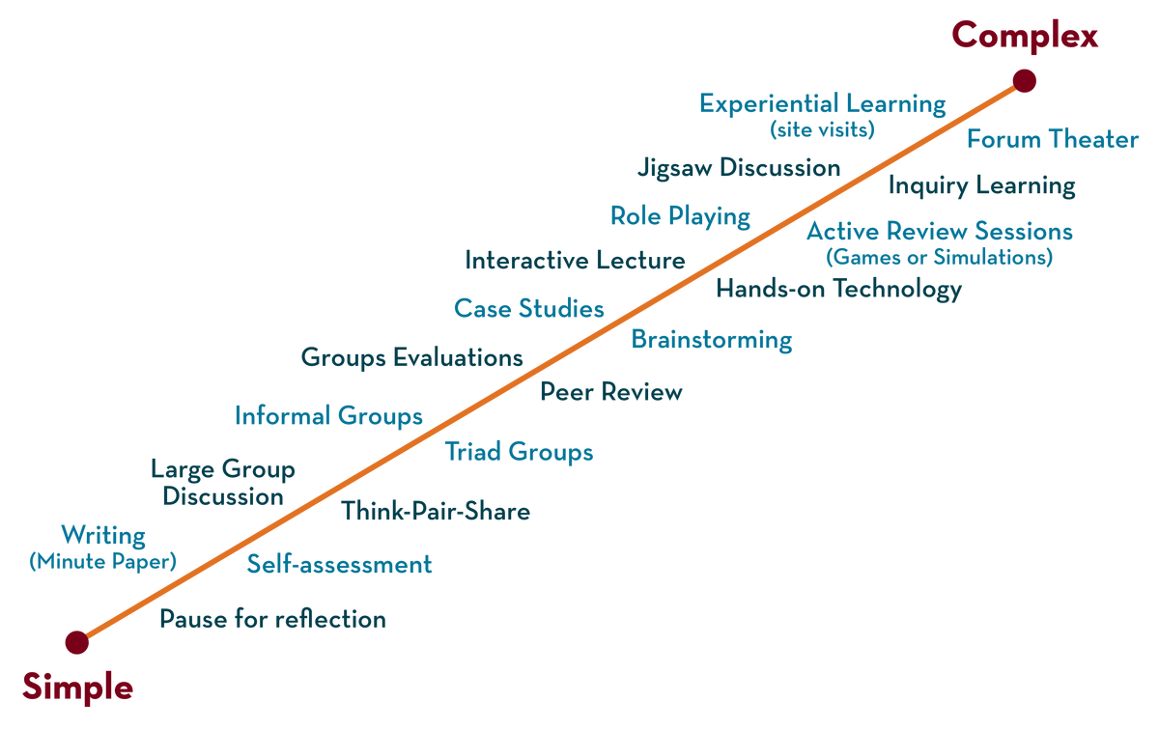
DEPARTMENT OF CSE , CSIT & AI&Ds
aDAPTIVE SOFTWARE ENGINEERING
COURSE CODE – 23CI2001
Topic:
Model Driven Architecture
Session -19

Slide 2

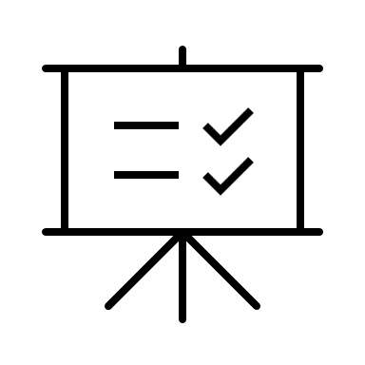

AIM OF THE SESSION
INSTRUCTIONAL OBJECTIVES
This Session is designed to:
Define SAFe
Describe foundations of SAFe
List out the uses of SAFe
Describe SAFe core values
LEARNING OUTCOMES
At the end of this session, you should be able to:
Define SAFe
Describe the foundations of SAFe
Summarize SAFe principles

Slide 3
Here are some of the key topics that are typically covered in a discussion of Model-Driven Architecture (MDA)
Introduction to MDA
Modeling Languages
Model Transformation
Model-Driven Engineering (MDE)
Model-Based Systems Engineering (MBSE)
Tools and Technologies
Case Studies
Future Directions

Slide 4
1.Introduction to MDA
This includes a brief history of MDA, its key principles and benefits, and an overview of its role in software development
Model-Driven Architecture (MDA) is a software development approach that emphasizes the use of models to design and build software systems. MDA is based on the idea of separation of concerns, where the design and implementation phases of software development are decoupled
The key benefit of MDA is that it promotes reuse of software components by creating models of these components that can be used in multiple systems. This reduces the time and effort required to develop software systems and improves their overall quality and maintainability

Slide 5
2.Modeling Languages
MDA relies on the use of modeling languages to create software models. Common modeling languages include UML, SysML, BPMN, and others. This topic covers the basics of modeling languages, their syntax and semantics, and their use in software modeling
In Model-Driven Architecture (MDA), modeling languages are used to create models that describe the structure, behavior, and functionality of software systems. Modeling languages provide a formal syntax and semantics for creating software models that can be understood by both humans and machines

Slide 6
Some of the commonly used modeling languages in MDA include
Unified Modeling Language (UML): UML is a general-purpose modeling language that is widely used in software engineering. It provides a rich set of graphical notations for modeling various aspects of software systems, including structure, behavior, and interactions
Systems Modeling Language (SysML): SysML is a modeling language that is based on UML and is designed specifically for systems engineering. It provides a set of graphical notations for modeling complex systems, including their structure, behavior, and interactions

Slide 7
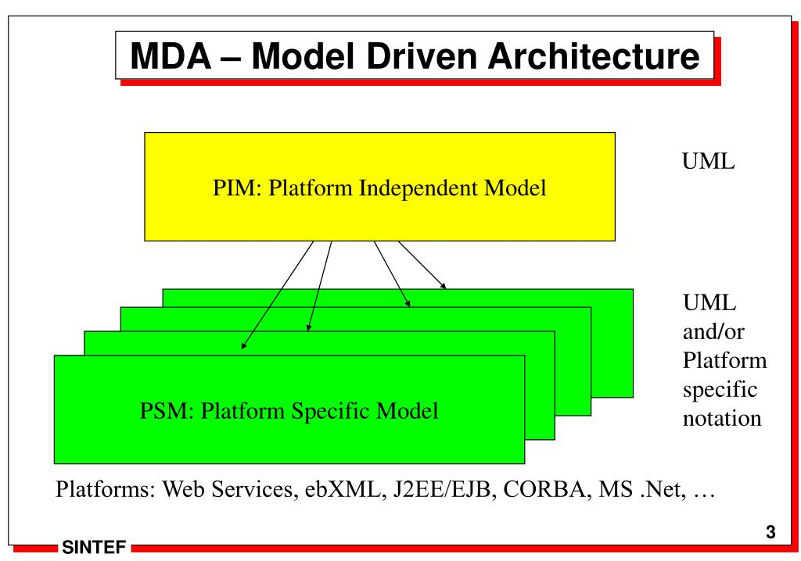
Mda-Architecture

Slide 8
CONTINUATION
Business Process Model and Notation (BPMN): BPMN is a modeling language that is used to model business processes. It provides a set of graphical notations for modeling the flow of activities, events, and data in a business process
Domain-Specific Modeling Languages (DSMLs): DSMLs are modeling languages that are designed specifically for a particular domain or application. They provide a set of graphical notations and modeling constructs that are tailored to the specific needs of the domain or application

Slide 9
3.Model Transformation
Model transformation is a key process in MDA, which involves converting one model into another model. This topic covers the types of model transformations, such as model-to-model and model-to-code transformations, and the tools and techniques used to perform them

Slide 10
4.Model-Driven Engineering (MDE)
MDE is an approach to software development that is closely related to MDA. This topic covers the basics of MDE, its principles, and its role in software development

Slide 11
5.Model-Based Systems Engineering (MBSE)
MBSE is another approach to systems engineering that is based on the use of models. This topic covers the basics of MBSE, its principles, and its relationship to MDA

Slide 12
6.Tools and Technologies
Tools and Technologies: MDA relies on a variety of tools and technologies, including modeling tools, transformation engines, and code generators. This topic covers the key tools and technologies used in MDA, their features and capabilities, and their strengths and weaknesses

Slide 13
7.Case Studies
Case studies provide practical examples of MDA in action, including its benefits, challenges, and best practices. This topic covers real-world examples of MDA implementations, their outcomes, and lessons learned

Slide 14
8.Future Directions
Future Directions: This topic covers the emerging trends and future directions in MDA, including the role of MDA in emerging technologies such as AI, machine learning, and cloud computing

Slide 15
SELF-ASSESSMENT QUESTIONS
What is Model Driven Architecture
Why to use Model Driven Architecture
When to Use Model Driven Architecture
Explain Foundations of Model Driven Architecture

Slide 16
REFERENCES FOR FURTHER LEARNING OF THE SESSION
TEXT BOOKS:
1 . Roger S.Pressman, “Software Engineering – A Practitioner’s Approach” 7th Edition, Mc Graw Hill,(2014).
2. Ian Sommerville, “Software Engineering”, Tenth Edition, Pearson Education, (2015).
Reference Book
Agile and Iterative Development: A Manager's Guide, Craig Larman, Addison-Wesley

Slide 17
WEB REFEReNCES/MOOCS:
:
https://www.digite.com/kanban/what-is-kanban/
http://www.scaledagileframework.com
https://www.guru99.com/test-driven-development.html
https://junit.org/junit5/

Slide 18
THANK YOU
Team – svv

